Slide 1
Quantified Self, Gender, Identity and Data subjectivity

Slide 2
Sociology and digital devices
Digital media and ‘Knowing capitalism’ (Thrift).
Production of new subjectivities through circulation of capital and data (Stanley).
‘different devices enact different populations as objects of concern and intervention’ (Ruppert).
Practices produce ‘data subjects’ who engage with other actors to identify and classify who they are (Ruppert, 2011: 224).
Notes:
The changes to social life and identity brought by the increased use of digital media and the more general impact of digital data have been presented as a new form of ‘knowing capitalism’ (Thrift). This is an analysis which seeks to understand the ways in which new forms of the circulation of capital and data are producing new subjectivities through reconfigured notions of time and space (Stanley, 2008: 535).

Slide 3
Quantified Self, Gender, Identity and Data Subjectivity
Aims
1. Understanding how you interact with and use devices to produce useful self-analysis.
2. Developing new methods of understanding the digital interactions of members through understanding interactions with devices and over digital media..

Slide 4
Specific Research Questions
What kinds of profiles to people maintain? What meaning do they attach to them? Are they used for constructing a sense of self for themselves, for display to others or merely for analytical purposes?
In what ways do people link with one another?
In what ways do people play or work with data?
How do they use visualisation? What role does visualisation play in their understanding of themselves?
What impact does metadata have on how people act and interact?
(Adapted from Beer and Burrows, 2013)

Slide 5
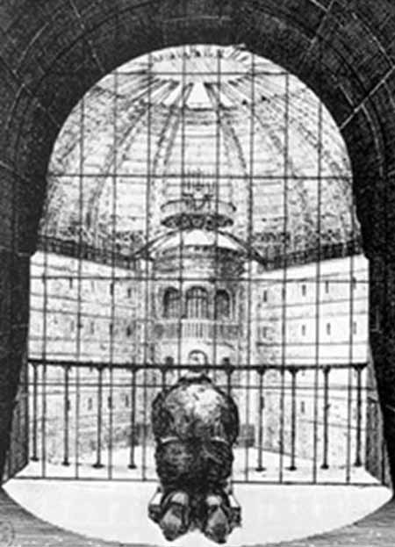
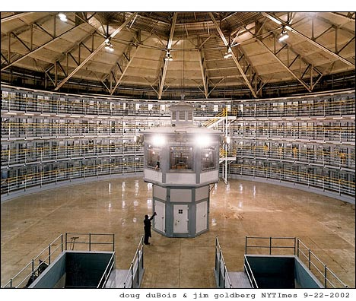
Surveillance?

Slide 6
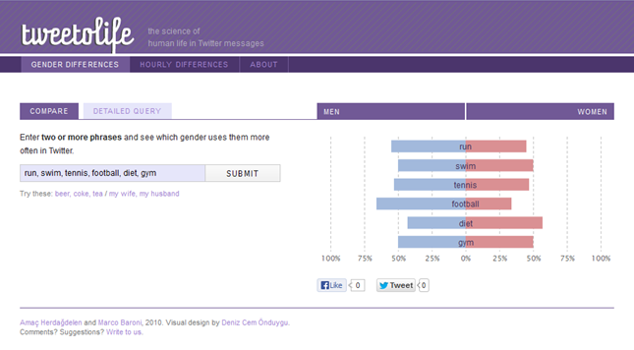

Slide 7
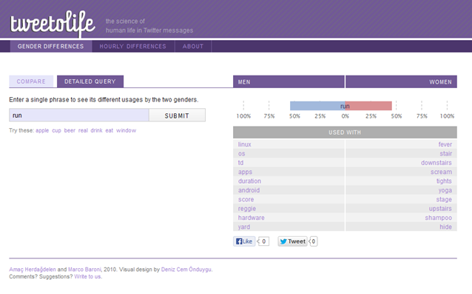

Slide 8
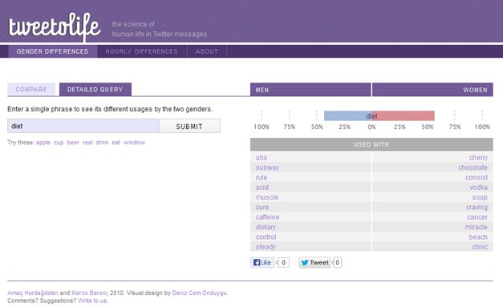

Slide 9
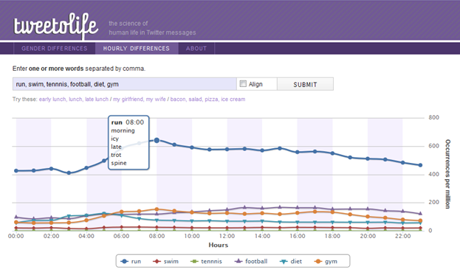

Slide 10
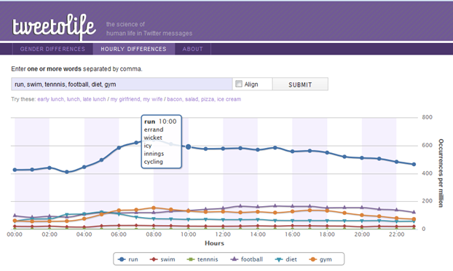

Slide 11
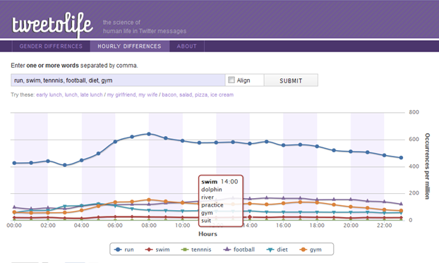

Slide 12
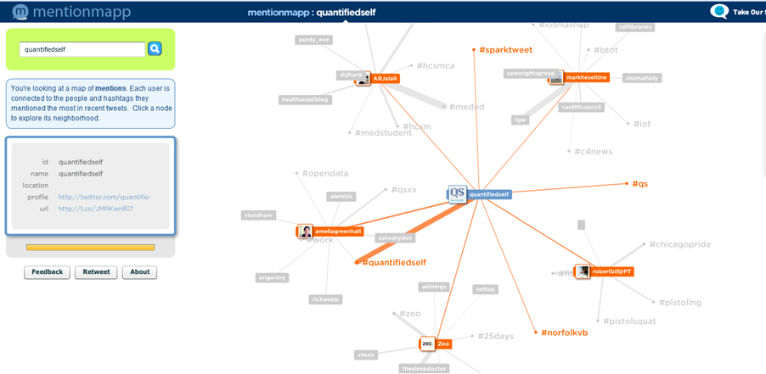

Slide 13
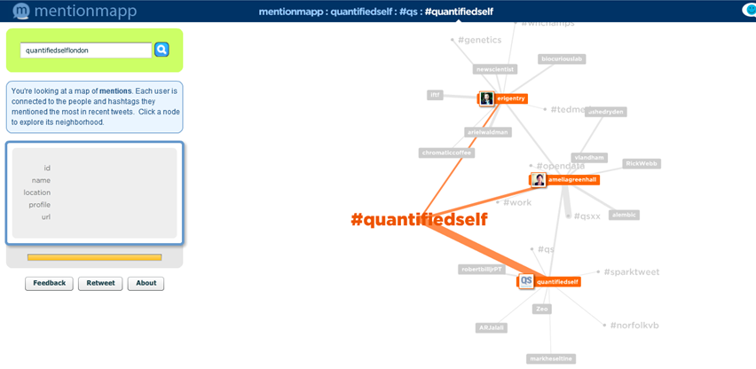

Slide 14
My details
christophertill@hotmail.co.uk
c.h.till@leeds.ac.uk
@chrishtill
0113 343 3571
http://www.sociology.leeds.ac.uk/people/staff/till

